Slide 1
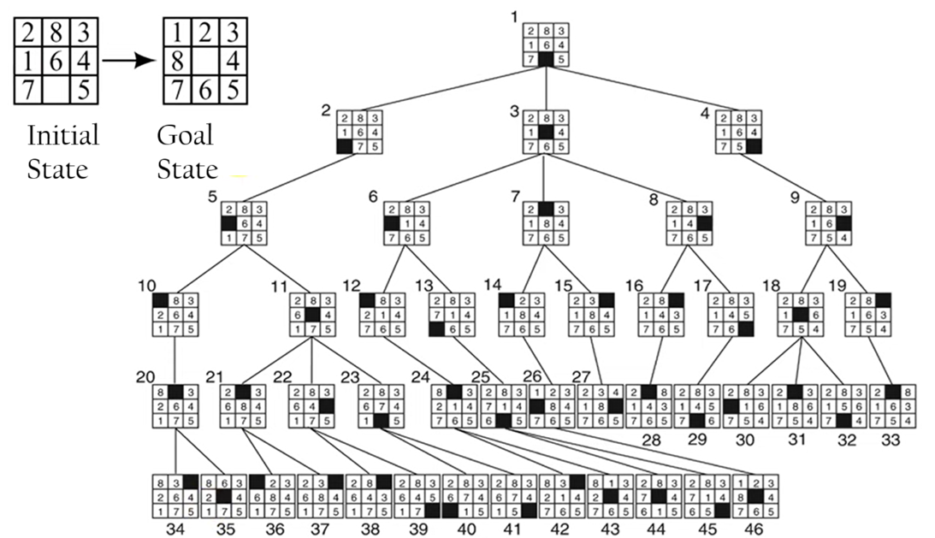
Q: Apply 8 Puzzle problems using the Best First Search (BFS) Algorithm
Achieved Goal State

Slide 2
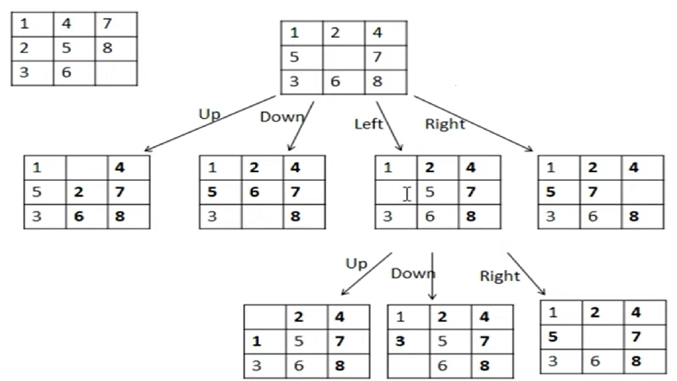
Initial State Goal State

Slide 3
